Slide 1
Lecture
Adjusting the Accounts
3
L.O. 3-1: Accrual-basis accounting and adjusting entries
L.O. 3-2: Adjusting entries for deferrals
L.O. 3-3: Adjusting entries for accruals
L.O. 3-4: Adjusted trial balance and financial statements
L.O. 4-2: Closing the books

Slide 2
The Accounting Cycle
1. Analyze business transactions
9. Prepare a post-closing trial balance
2. Journalize the transactions
8. Journalize and post closing entries
3. Post to ledger accounts
7. Prepare financial statements
4. Prepare a trial balance
6. Prepare an adjusted trial balance
5. Journalize and post adjusting entries

Slide 3
Learning Objective 3-1
Accrual-Basis Accounting and
Adjusting Entries

Slide 4
Outline
Fiscal and calendar years
Accrual- vs. cash-basis accounting
Revenue recognition principle
Expense recognition principle
The need for adjusting entries
Types of adjusting entries

Slide 5
Fiscal and Calendar Years
Time period assumption: Accountants divide the economic life of a business into artificial (accounting) time periods.
. . . . .
Jan.
Feb.
Mar.
Apr.
Dec.
Generally.
a month,
a quarter, or
a year.
Fiscal Year = accounting time period that is one year in length.
Calendar Year = Jan. 1 to Dec. 31.

Slide 6
Accrual- vs. Cash-Basis Accounting
Accrual basis
Cash basis
Transactions recorded in the periods in which the events occur.
Companies recognize revenues when they perform services (rather than when they receive cash).
Expenses are recognized when incurred (rather than when paid)
Revenues are recorded when cash is received.
Expenses are recorded when cash is paid.
Cash-basis accounting is not in accordance with generally accepted accounting principles (GAAP).

Slide 7
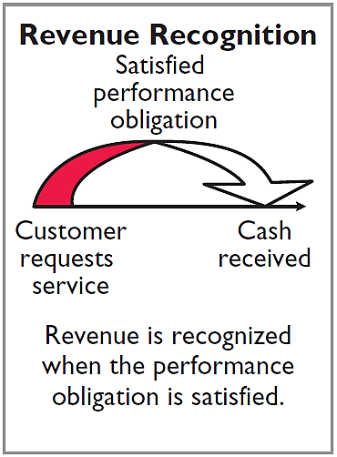
Revenue Recognition Principle
Recognize revenue in the accounting period in which the performance obligation is satisfied.

Slide 8
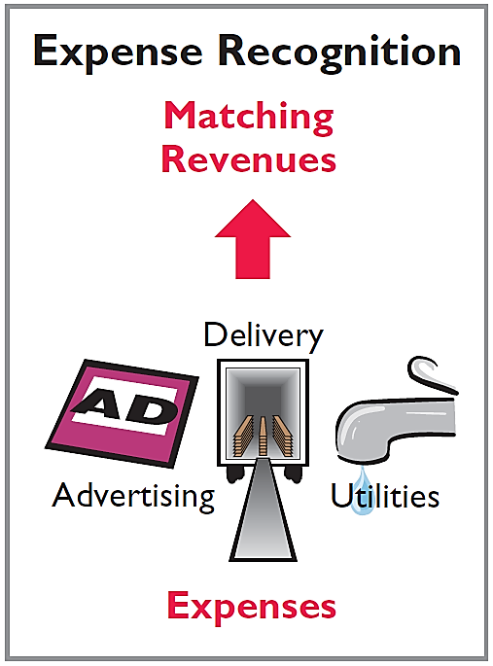
Expense Recognition Principle
Match expenses with revenues in the period when the company makes efforts to generate those revenues.
“Let the expenses follow the revenues.”

Slide 9
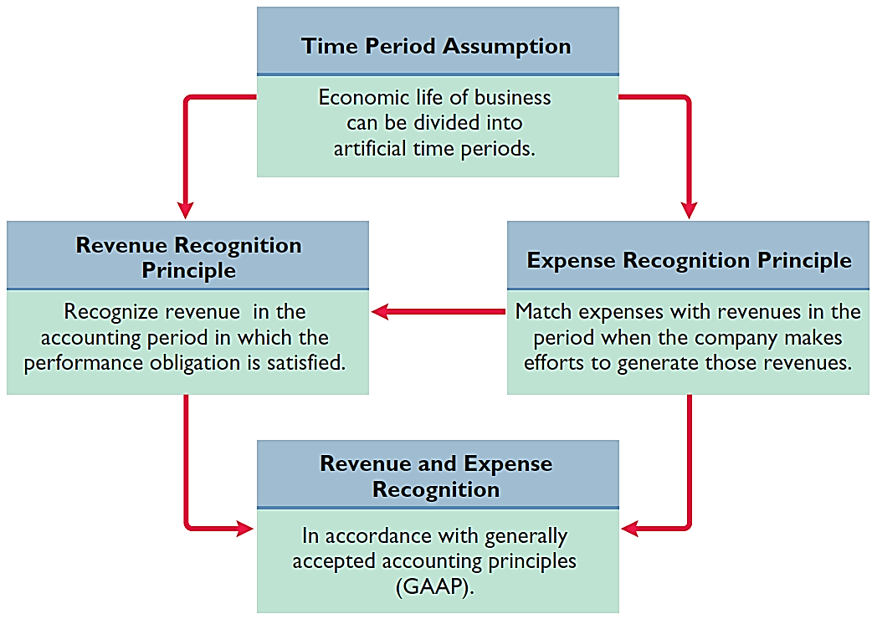
GAAP Relationships

Slide 10
The Need for Adjusting Entries
Adjusting Entries
Necessary because the trial balance may not contain up-to-date and complete data.
Ensure that the revenue recognition and expense recognition principles are followed.
Required every time a company prepares financial statements.
Will include one income statement account and one balance sheet account.

Slide 11
Types of Adjusting Entries
Deferrals
Accruals
1. Prepaid Expenses. Expenses paid in cash before they are used or consumed.
1. Accrued Revenues. Revenues for services performed but not yet received in cash or recorded.
2. Unearned Revenues.
Cash received before services are performed.
2. Accrued Expenses. Expenses incurred but not yet paid in cash or recorded.

Slide 12
Recognizing Revenues and Expenses
Question
One of the following statements about the accrual basis of accounting is false? That statement is:
Events that change a company’s financial statements are recorded in the periods in which the events occur.
Revenue is recognized in the period in which the performance obligation is satisfied.
The accrual basis of accounting is in accordance with generally accepted accounting principles.
Revenue is recorded only when cash is received, and expenses are recorded only when cash is paid.

Slide 13
The Need for Adjusting Entries
Question
Adjusting entries are made to ensure that:
expenses are recognized in the period in which they are incurred.
revenues are recorded in the period in which services are performed.
balance sheet and income statement accounts have correct balances at the end of an accounting period.
all of the above.

Slide 14
Learning Objective 3-2
Adjusting Entries for Deferrals

Slide 15
Outline
The trial balance
Deferrals
Prepaid expenses
Unearned revenue

Slide 16
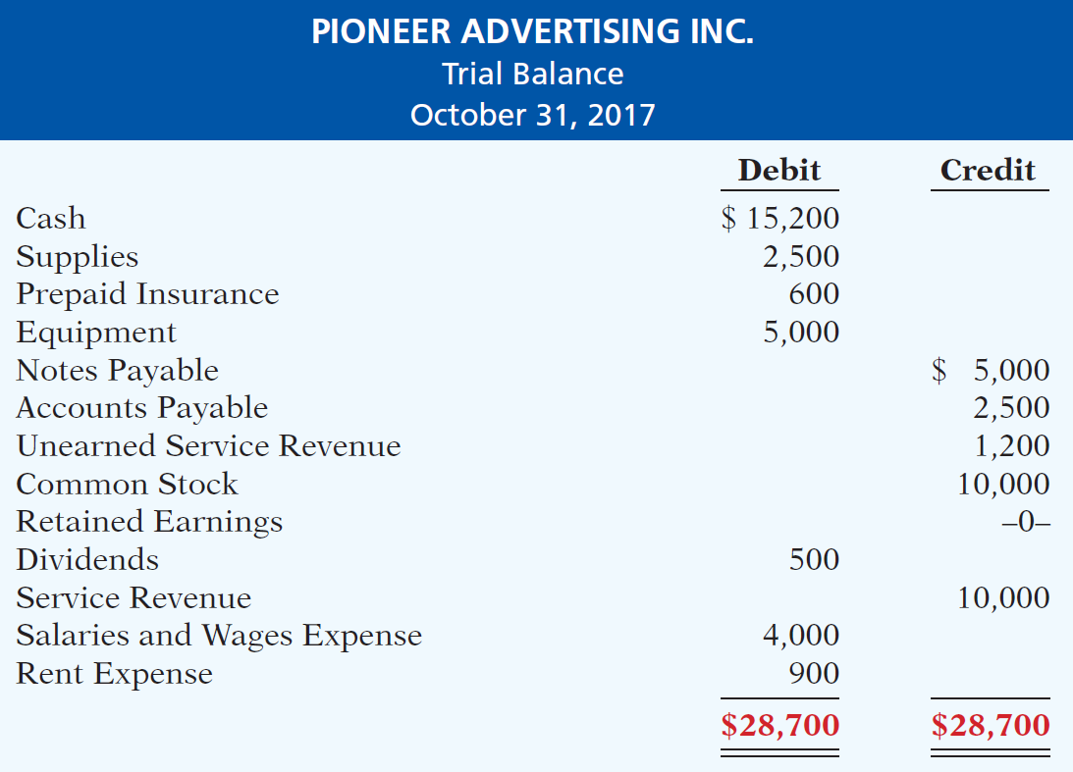
The Trial Balance
Each account is analyzed to determine whether it is complete and up-to-date for financial statement purposes.

Slide 17
Deferrals
Deferrals are expenses or revenues that are recognized at a date later than the point when cash was originally exchanged. There are two types:
Prepaid expenses and
Unearned revenues.

Slide 18
Prepaid Expenses
Payments of expenses that will benefit more than one accounting period.
Cash Payment
BEFORE
Expense Recorded
Prepayments often occur in regard to:
Insurance
Supplies
Advertising
Rent
Buildings and equipment

Slide 19
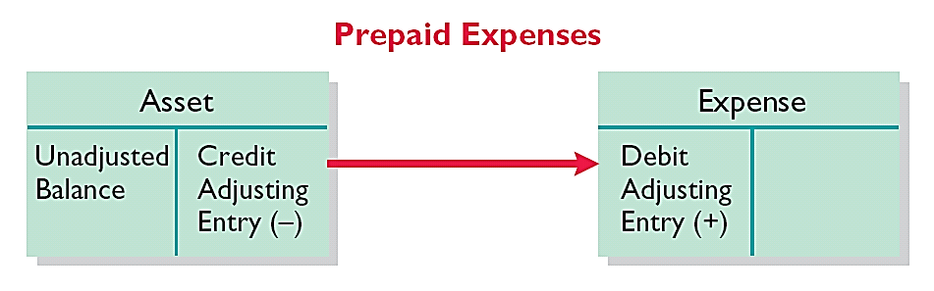
Prepaid Expenses
Expire either with the passage of time or through use.
Adjusting entry:
Increase (debit) to an expense account and
Decrease (credit) to an asset account.

Slide 20
The Trial Balance

Slide 21
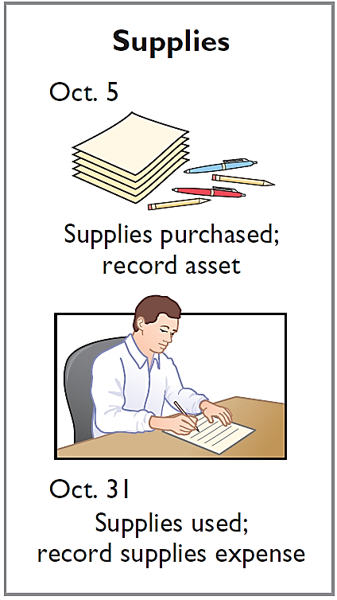
Prepaid Expenses – Supplies
Illustration:
Pioneer Advertising Inc. Inc. purchased supplies costing $2,500 on October 5. Pioneer recorded the purchase by increasing (debiting) the asset Supplies. This account shows a balance of $2,500 in the October 31 trial balance. An inventory count at the close of business on October 31 reveals that $1,000 of supplies are still on hand.

Slide 22
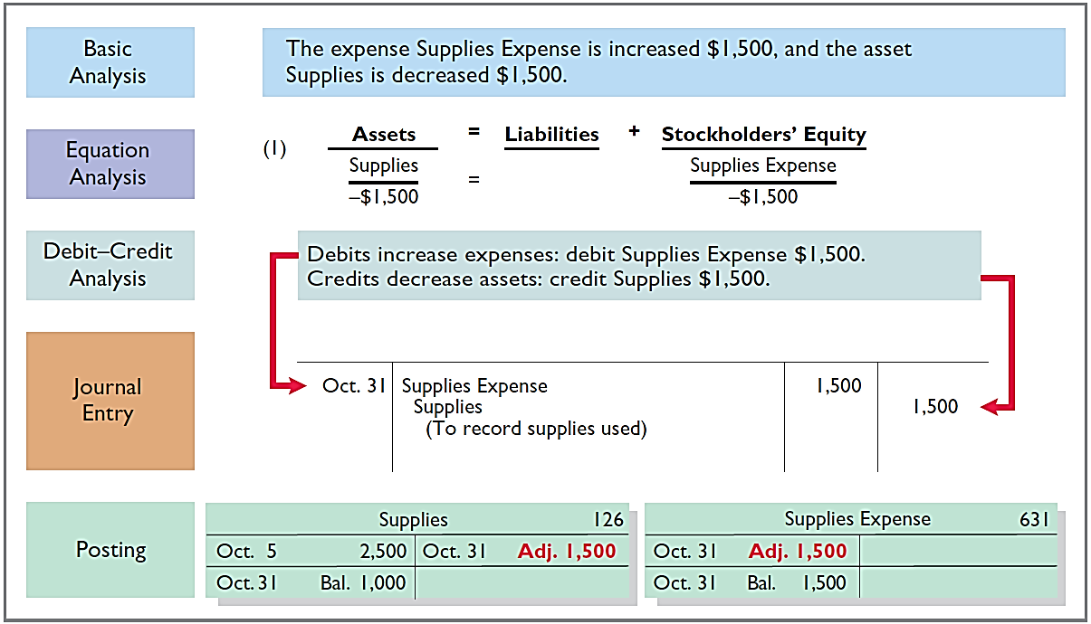
Prepaid Expenses – Supplies

Slide 23
The Trial Balance

Slide 24
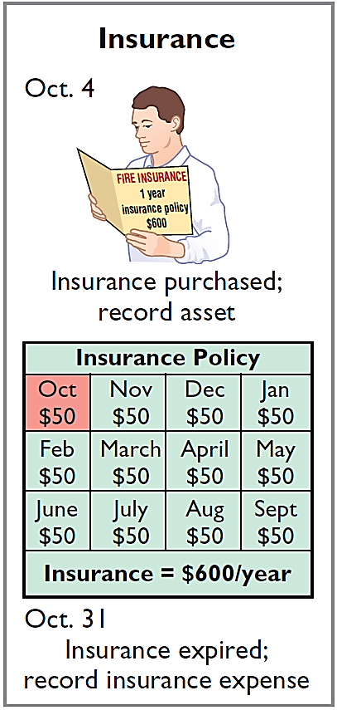
Prepaid Expenses – Insurance
Illustration:
On October 4, Pioneer Advertising Inc. paid $600 for a one-year fire insurance policy. Coverage began on October 1. Pioneer recorded the payment by increasing (debiting) Prepaid Insurance. This account shows a balance of $600 in the October 31 trial balance. Insurance of $50 ($600 / 12) expires each month.

Slide 25
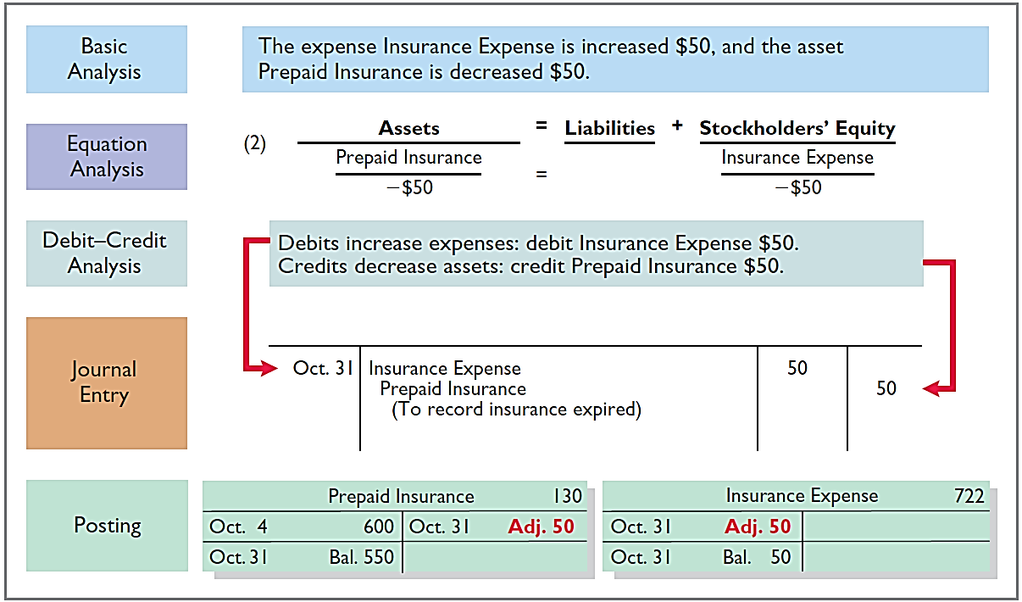
Prepaid Expenses – Insurance

Slide 26
The Trial Balance

Slide 27
Prepaid Expenses – Equipment
Buildings, equipment, and motor vehicles (assets that provide service for many years) are recorded as assets, rather than an expense, on the date acquired.
Depreciation is the process of allocating the cost of an asset to expense over its useful life.
Depreciation does not attempt to report the actual change in the value of the asset.

Slide 28
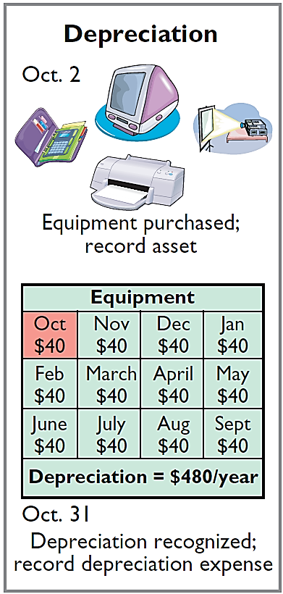
Prepaid Expenses – Equipment
Illustration:
For Pioneer Advertising, assume that depreciation on the equipment is $480 a year, or $40 per month.

Slide 29
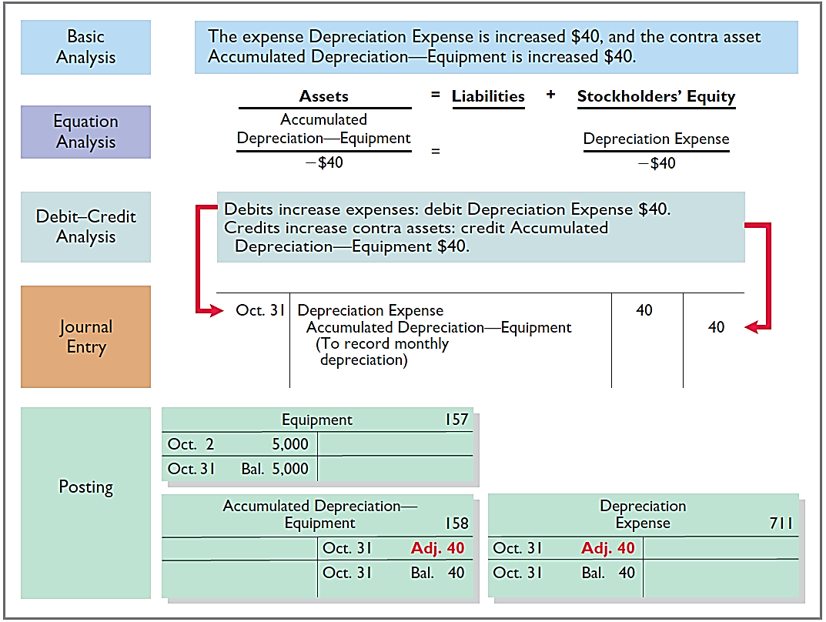
Prepaid Expenses – Equipment

Slide 30
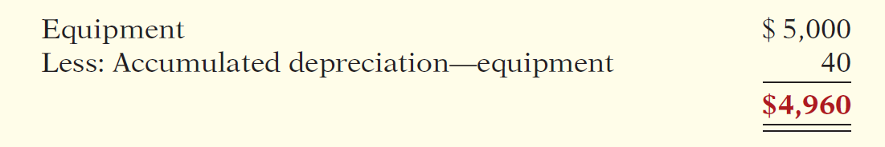
Prepaid Expenses – Equipment
Statement Presentation
Accumulated Depreciation is a contra asset account (credit).
Appears just after the account it offsets (Equipment) on the balance sheet.
Book value is the difference between the cost of any depreciable asset and its accumulated depreciation.

Slide 31
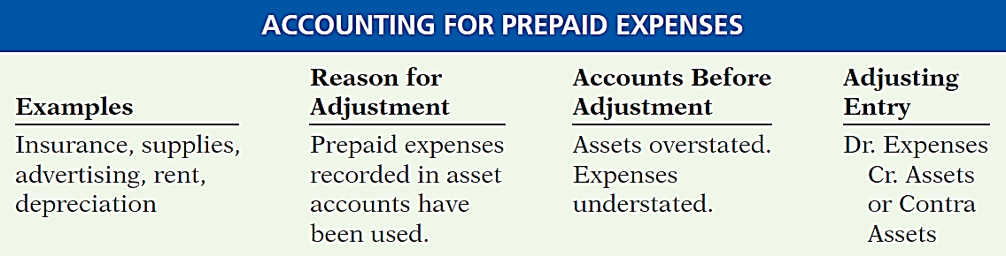
Prepaid Expenses

Slide 32
Unearned Revenues
Receipt of cash that is recorded as a liability because the service has not been performed.
Cash Receipt
BEFORE
Revenue Recorded
Unearned revenues often occur in regard to:
Rent
Airline tickets
Magazine subscriptions
Customer deposits

Slide 33
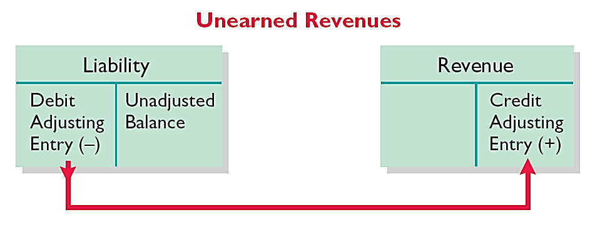
Unearned Revenues
Adjusting entry is made to record the revenue for services performed during the period and to show the liability that remains at the end of the accounting period.
Results in a decrease (debit) to a liability account and an increase (credit) to a revenue account.

Slide 34
The Trial Balance

Slide 35
Unearned Revenues
Illustration:
Pioneer Advertising Inc. received $1,200 on October 2 from R. Knox for advertising services expected to be completed by December 31.
Unearned Service Revenue shows a balance of $1,200 in the October 31 trial balance. Analysis reveals that the company performed $400 of services in October.

Slide 36
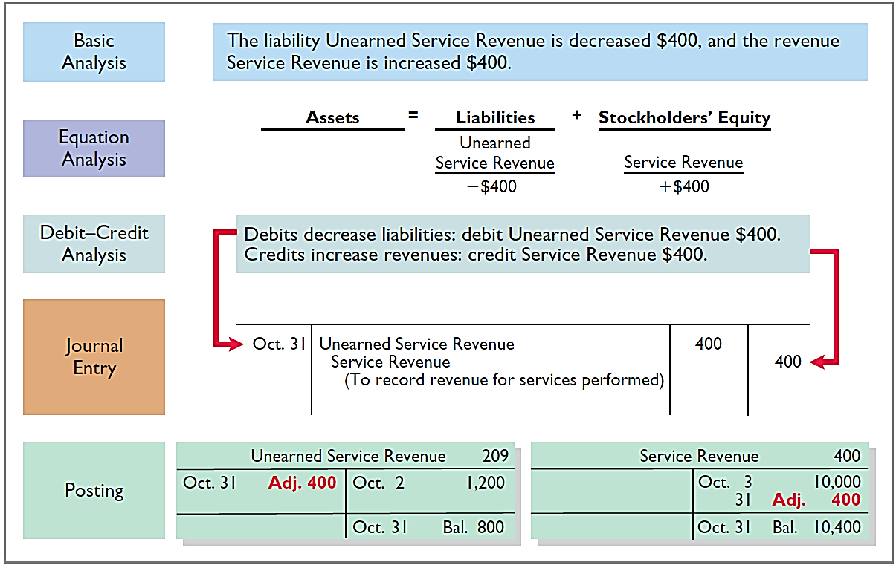
Unearned Revenues

Slide 37
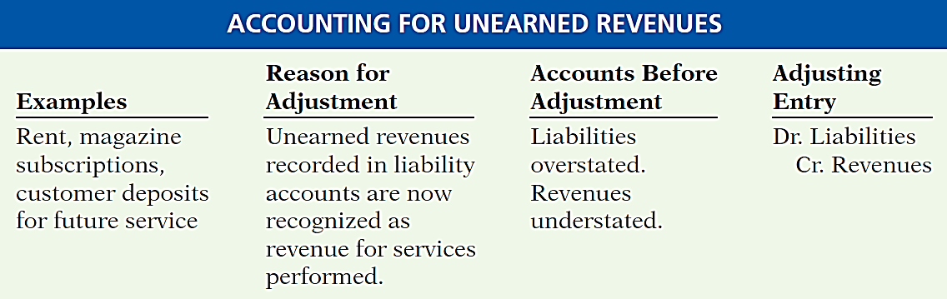
Unearned Revenues

Slide 38
Learning Objective 3-3
Adjusting Entries for Accruals

Slide 39
Outline
Accruals
Accrued revenues
Accrued expenses

Slide 40
Accruals
Accruals are made to record
Revenues for services performed but not yet received in cash or recorded at the statement date (accrued revenues).
OR
Expenses incurred but not yet paid in cash or recorded at the statement date (accrued expenses).

Slide 41
Accrued Revenues
Revenues for services performed but not yet received in cash or recorded.
Revenue Recorded
BEFORE
Cash Receipt
Accrued revenues often occur in regard to:
Rent
Interest
Services performed

Slide 42
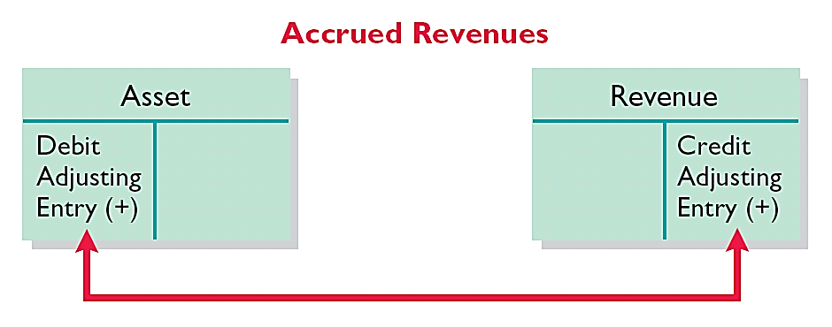
Accrued Revenues
Adjusting entry records the receivable that exists and records the revenues for services performed.
Adjusting entry:
Increases (debits) an asset account and
Increases (credits) a revenue account.

Slide 43
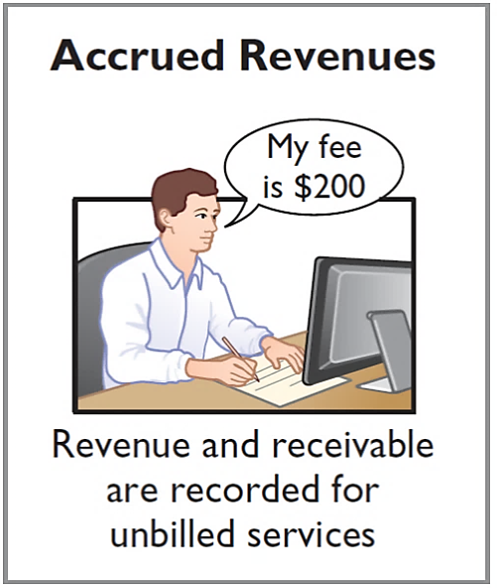
Accrued Revenues
Illustration:
In October, Pioneer Advertising Inc. performed services worth $200 that were not billed to clients in October.

Slide 44
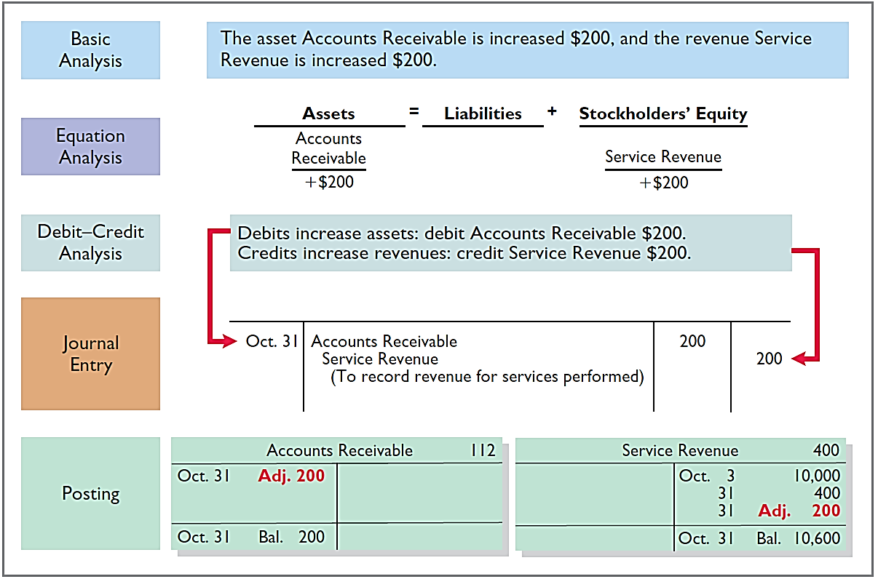
Accrued Revenues

Slide 45
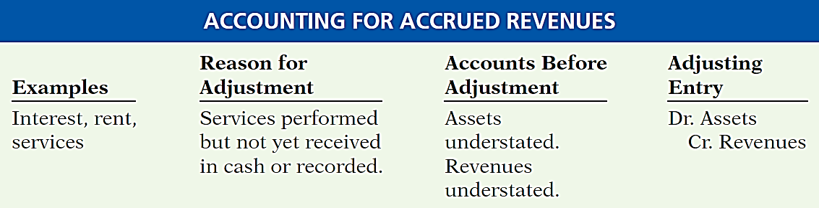
Accrued Revenues

Slide 46
Accrued Expenses
Expenses incurred but not yet paid in cash or recorded.
Expense Recorded
BEFORE
Cash Payment
Accrued expenses often occur in regard to:
Interest
Taxes
Salaries

Slide 47
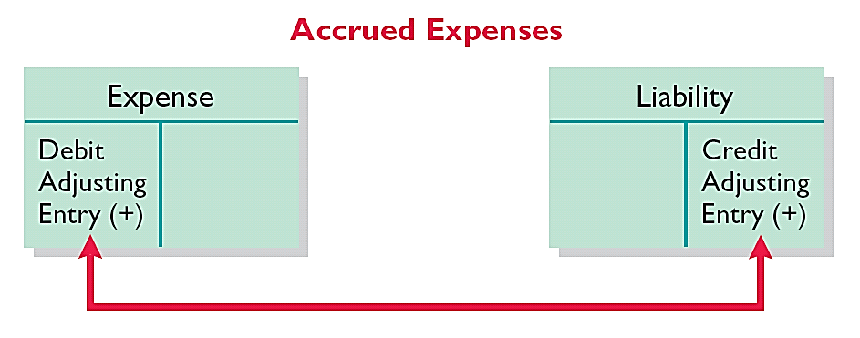
Accrued Expenses
Adjusting entry records the obligation and recognizes the expense.
Adjusting entry:
Increase (debit) an expense account and
Increase (credit) a liability account.

Slide 48
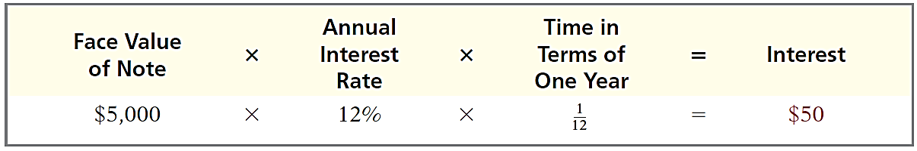
Accrued Expenses
Illustration:
Pioneer Advertising Inc. signed a three-month note payable in the amount of $5,000 on October 1. The note requires Pioneer to pay interest at an annual rate of 12%.

Slide 49
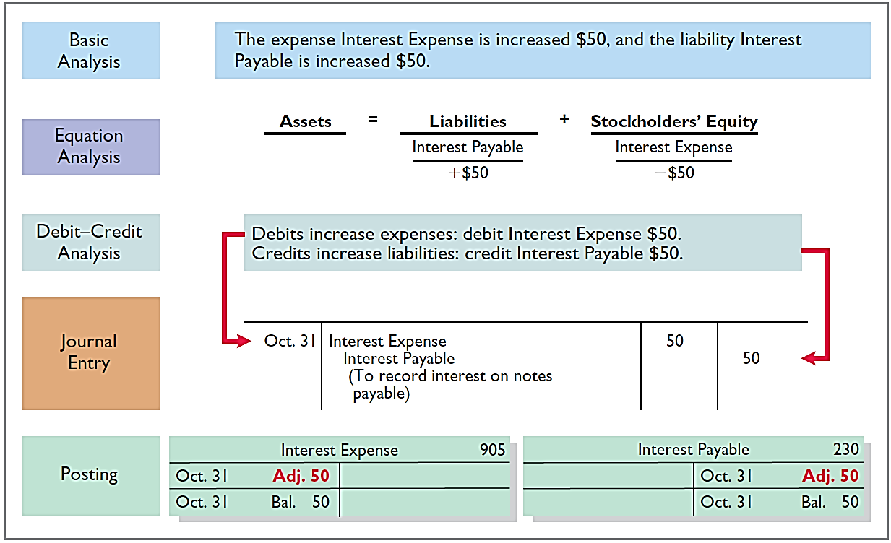
Accrued Expenses

Slide 50
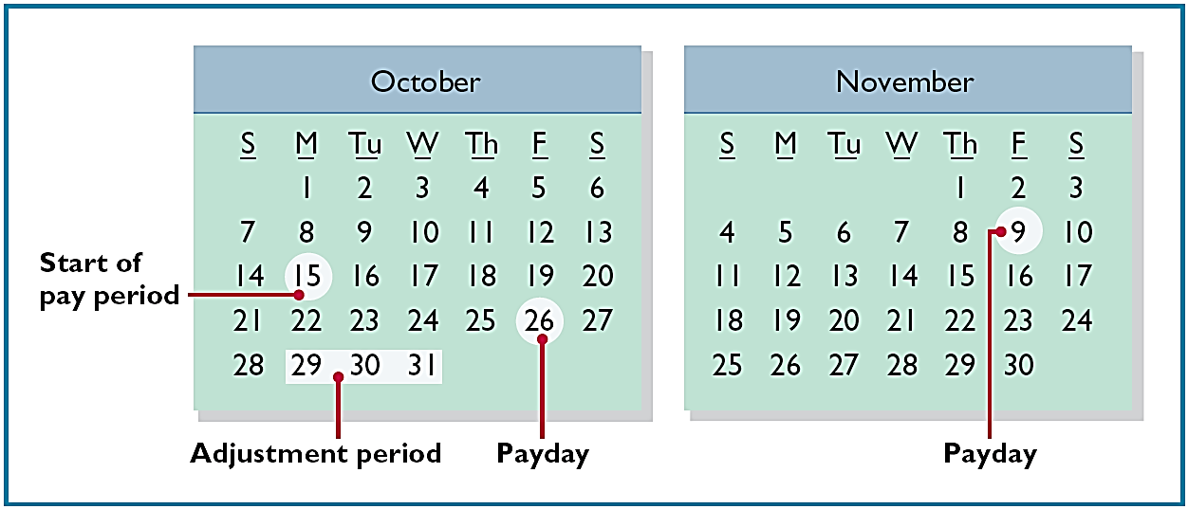
Accrued Expenses
Illustration:
Pioneer paid salaries and wages on October 26; the next payment of salaries will not occur until November 9. The employees receive total salaries of $2,000 for a five-day work week, or $400 per day. Thus, accrued salaries at October 31 are $1,200 ($400 x 3 days).

Slide 51
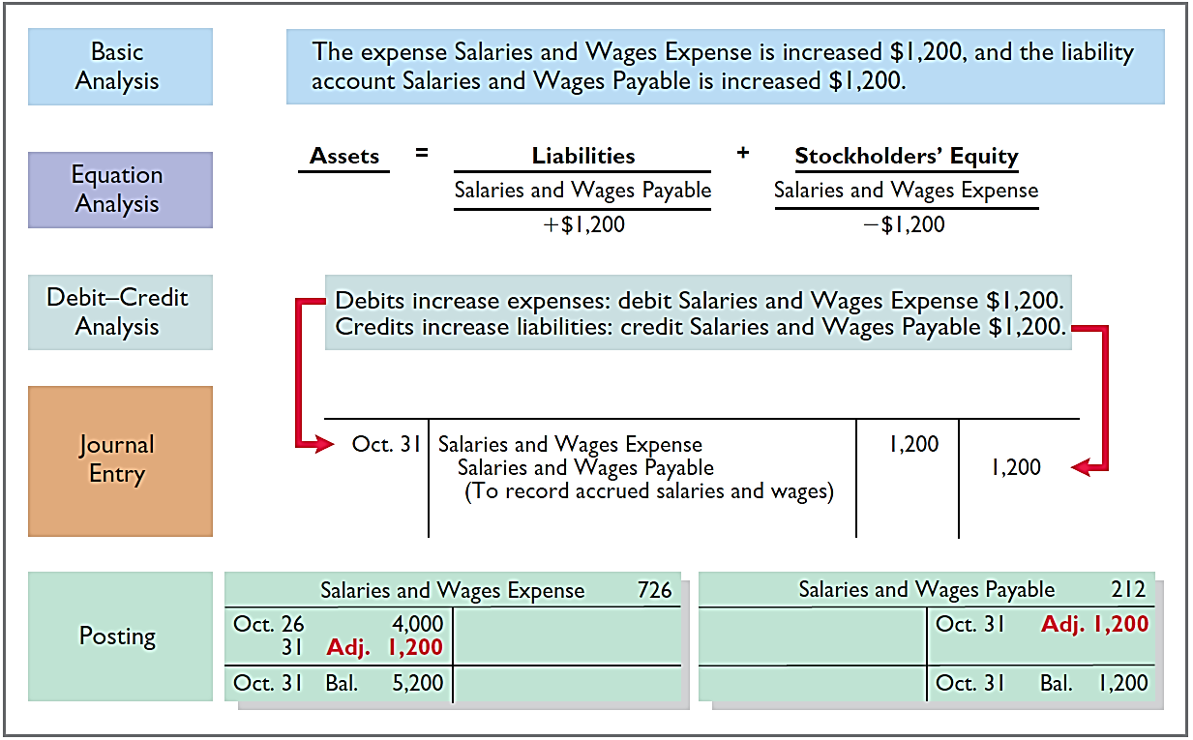
Accrued Expenses

Slide 52
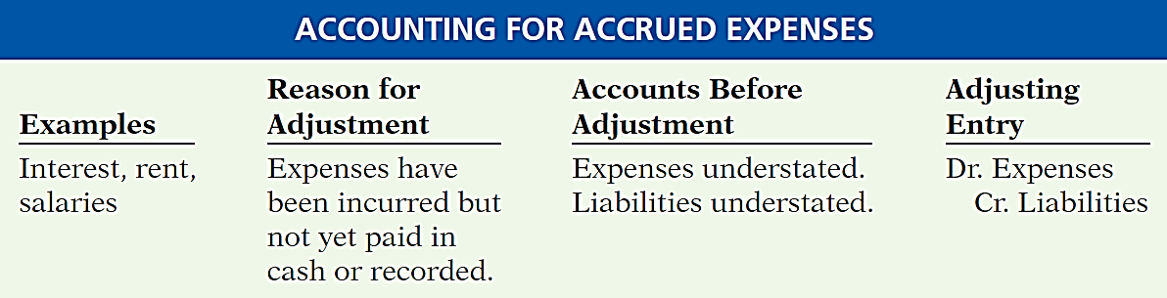
Accrued Expenses

Slide 53
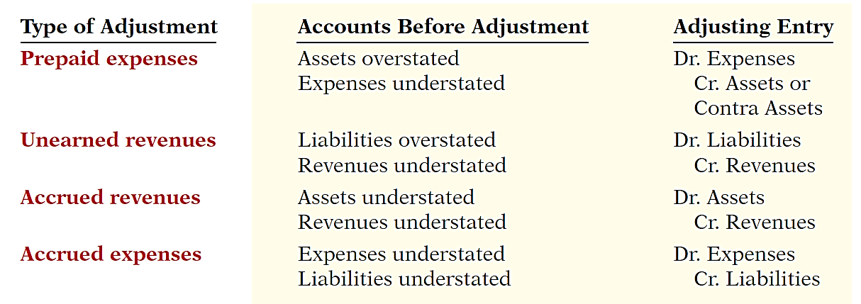
Summary of Basic Relationships

Slide 54
Learning Objective 3-4
Adjusted Trial Balance and
Financial Statements

Slide 55
Outline
The adjusted trial balance
Preparing financial statements

Slide 56
The Accounting Cycle
1. Analyze business transactions
9. Prepare a post-closing trial balance
2. Journalize the transactions
8. Journalize and post closing entries
3. Post to ledger accounts
7. Prepare financial statements
4. Prepare a trial balance
6. Prepare an adjusted trial balance
5. Journalize and post adjusting entries

Slide 57
The Adjusted Trial Balance
Prepared after all adjusting entries are journalized and posted.
Purpose is to prove the equality of debit balances and credit balances in the ledger.
Is the primary basis for the preparation of financial statements.

Slide 58
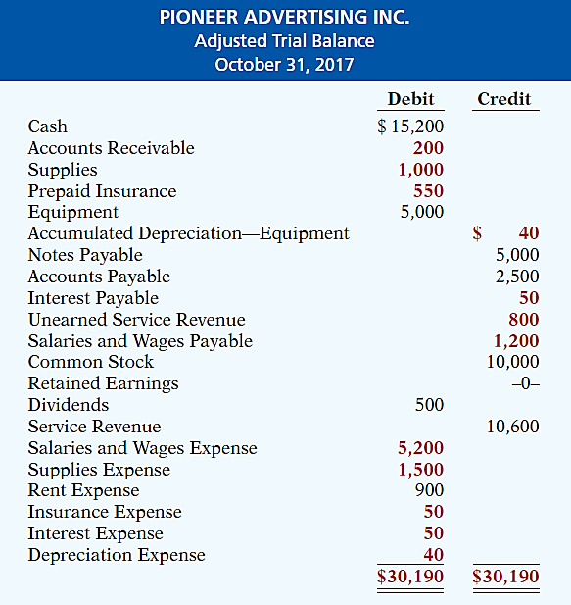

Slide 59
Preparing Financial Statements
Financial Statements are prepared directly from the Adjusted Trial Balance.
Income Statement
Retained Earnings Statement
Balance Sheet

Slide 60
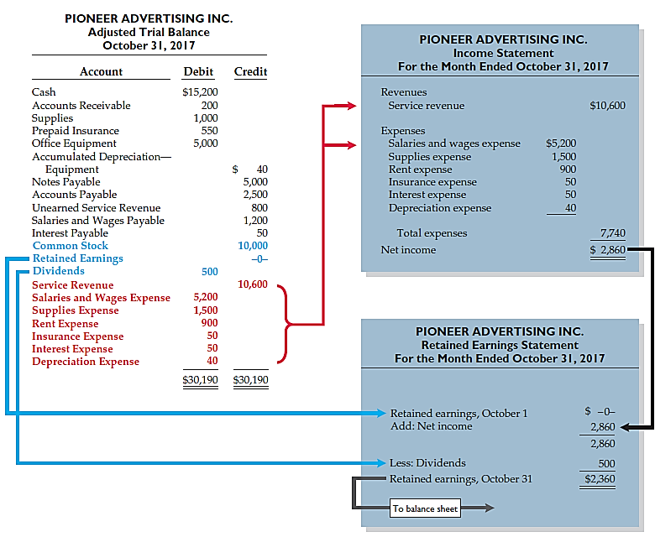

Slide 61
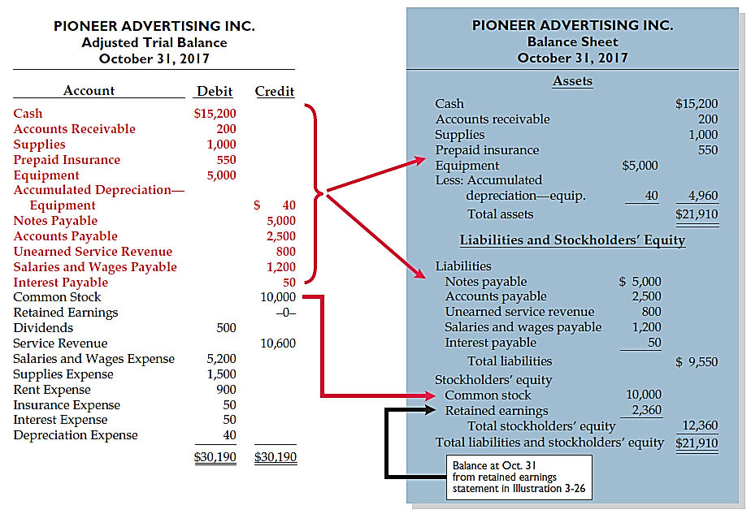

Slide 62
Learning Objective 4-2
Closing the Books

Slide 63
Outline
Preparing closing entries
Preparing a post-closing trial balance

Slide 64
The Accounting Cycle
1. Analyze business transactions
9. Prepare a post-closing trial balance
2. Journalize the transactions
8. Journalize and post closing entries
3. Post to ledger accounts
7. Prepare financial statements
4. Prepare a trial balance
6. Prepare an adjusted trial balance
5. Journalize and post adjusting entries

Slide 65
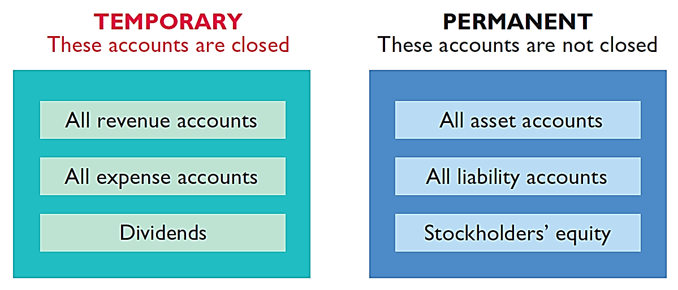
Preparing Closing Entries
At the end of the accounting period, the company makes the accounts ready for the next period.

Slide 66
Preparing Closing Entries
Closing entries formally recognize in the ledger the transfer of
Net income (or net loss) and
Dividends
to Retained Earnings.
Companies generally journalize and post closing entries only at the end of the annual accounting period.
Closing entries produce a zero balance in each temporary account.

Slide 67
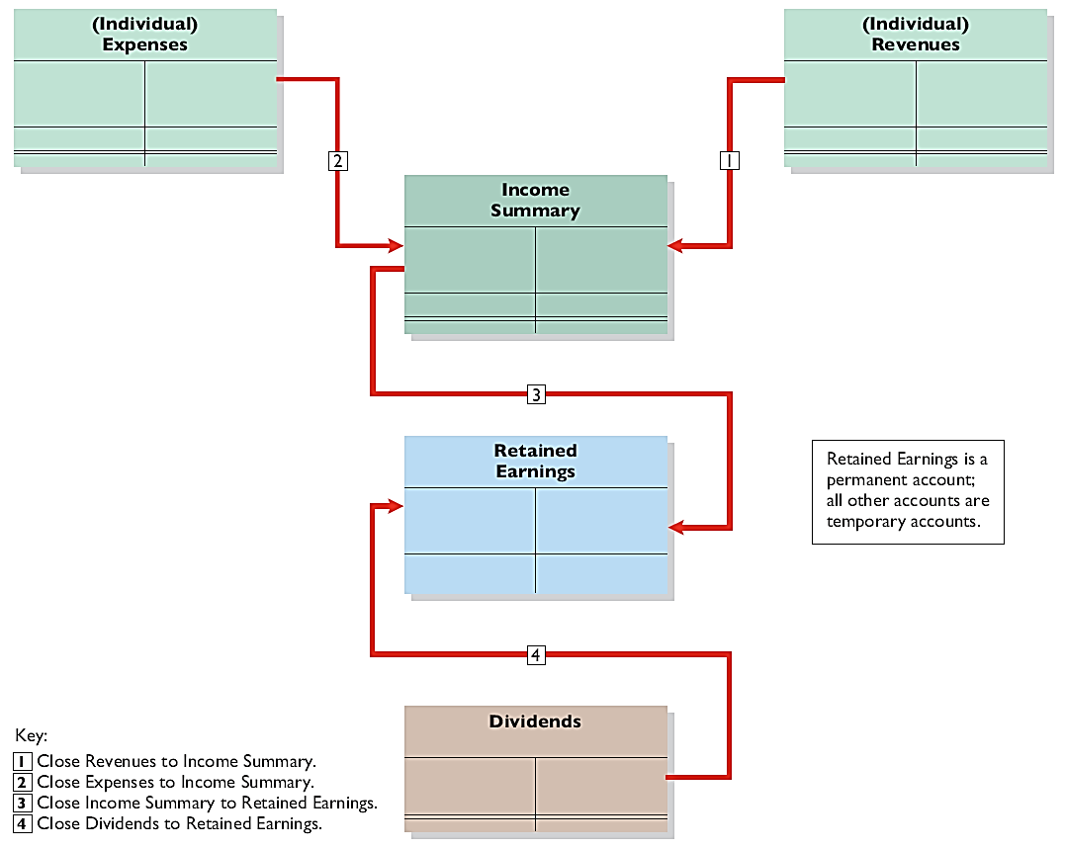
Preparing Closing Entries
Illustration 4-5
Diagram of closing process—corporation

Slide 68
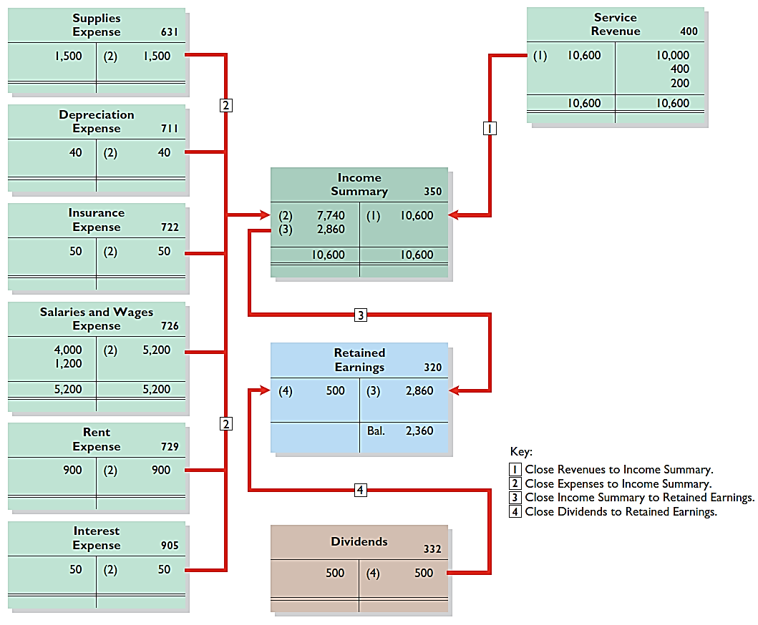
Posting Closing Entries

Slide 69
Permanent
accounts
Temporary
accounts

Slide 70
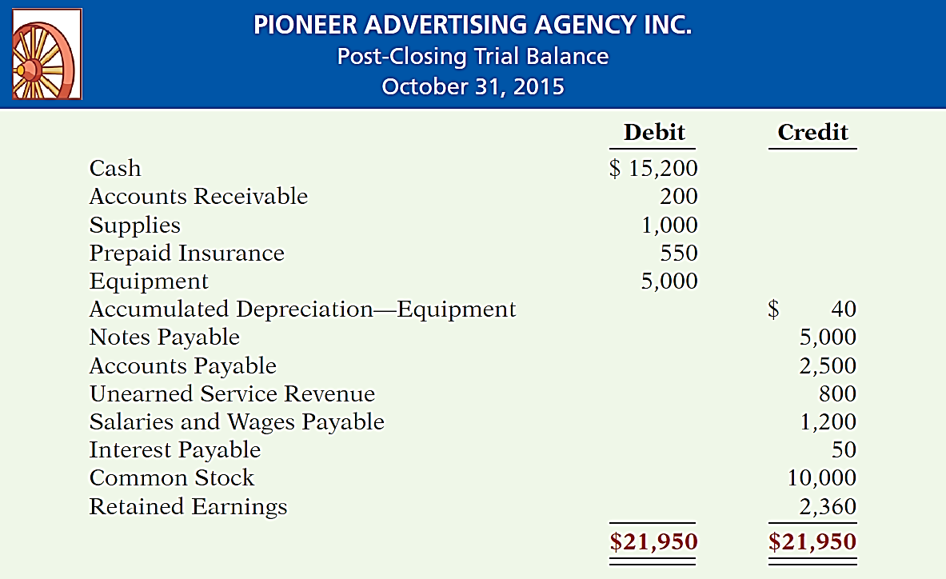
Preparing a Post-Closing Trial Balance
Purpose is to prove the equality of the permanent account balances carried forward into the next accounting period.
Illustration 4-8

